Slide 1
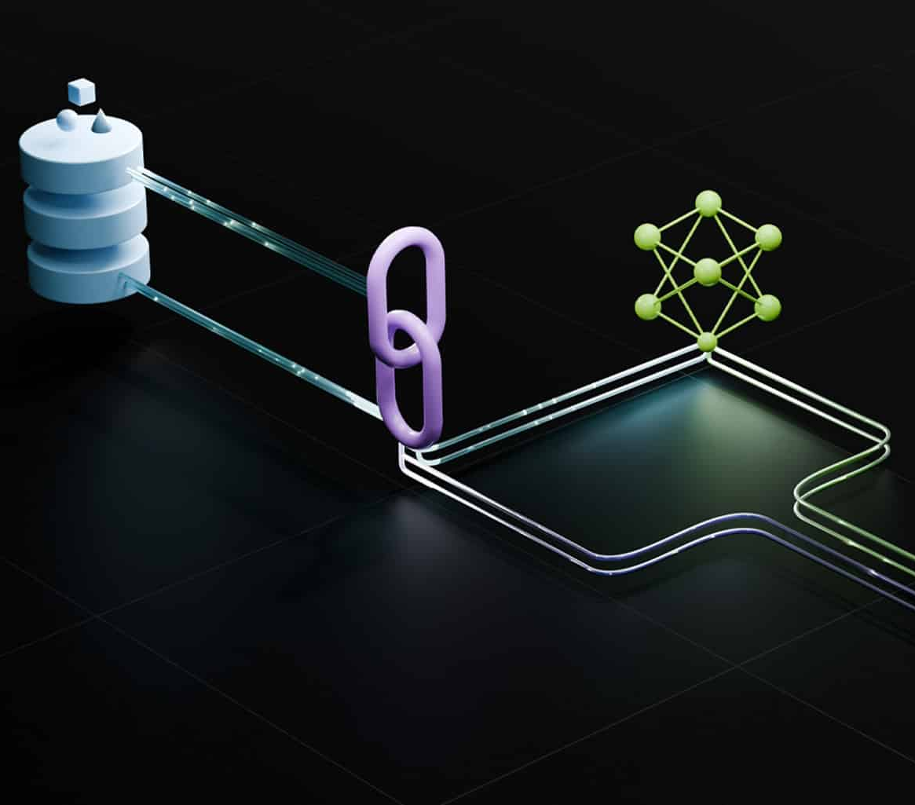
Boosting RAG Performance with Noise-Infused Retrieval Strategies
TEAM – Sandhya Lotla, Sindhu Gajulapalli, Mallikarjuna Bandi
DATE – April 26, 2025

Slide 2
Problem Statement: Retrieval-Augmented Generation (RAG) assumes that more relevant retrieval = better LLM performance. This project challenges that assumption. What if adding irrelevant (noise) documents affects or even sometimes helps model performance?
Project Objective Evaluate how adding random noise documents affects LLM short-answer accuracy.
Study how document ordering, retrieval entropy, and number of noise documents influence output.
Identify patterns of attention collapse or stability.

Slide 3
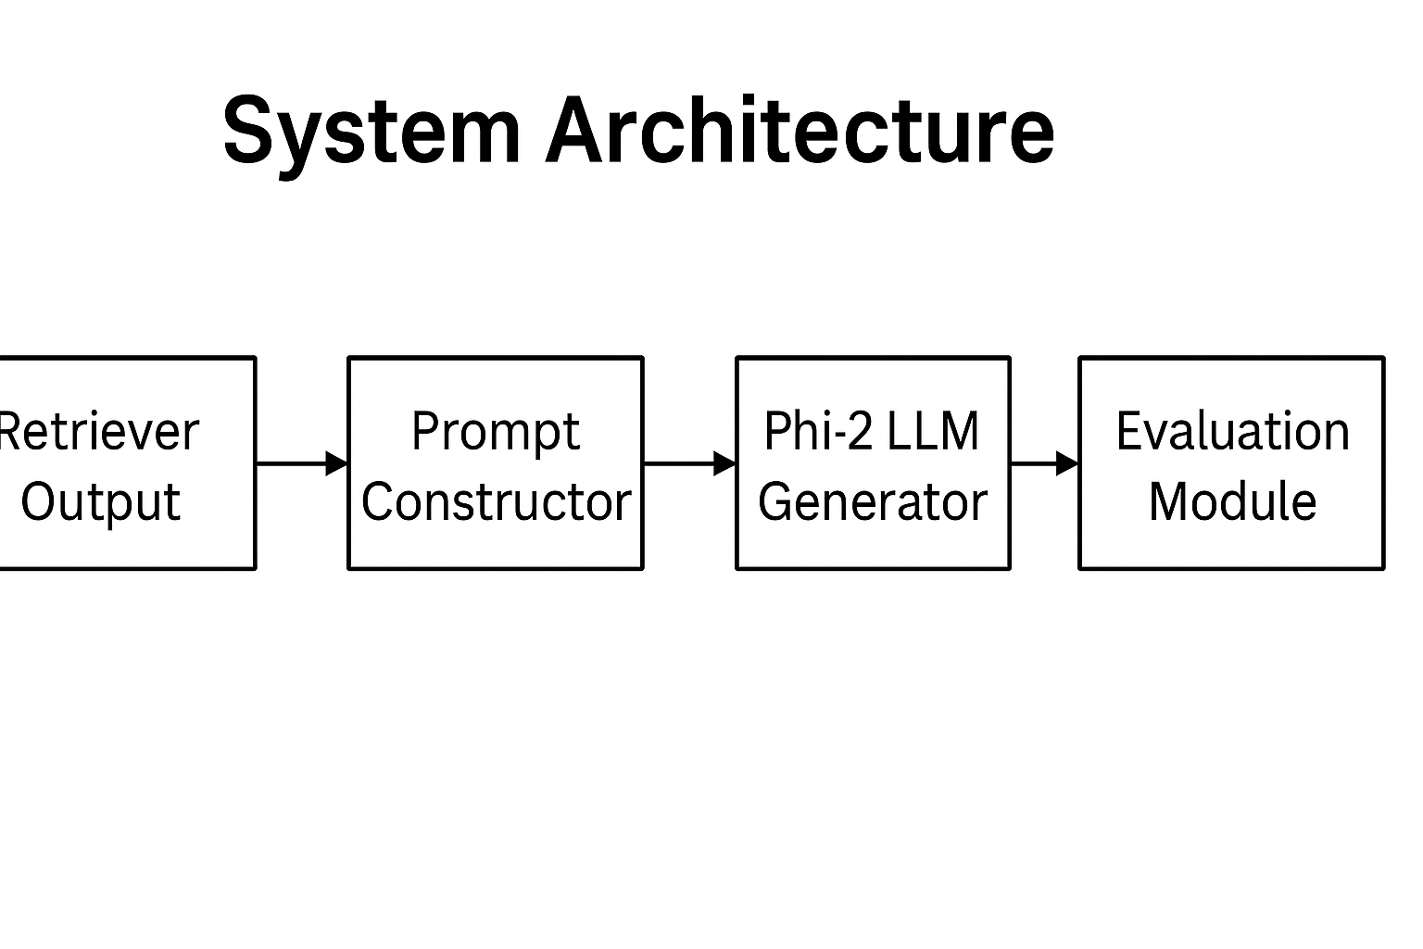
Dataset and Corpus: Natural Questions: Real-world QA dataset (~10k queries). Wikipedia Corpus: Sampled subset (~50k passages). Noise Corpus: Randomly sampled synthetic passages.
Methodology: Construct prompts: 1 Gold document + N Noise documents.
Vary noise levels: 1, 2, 3, 4.
Generate answers with Phi-2 LLM (max 5 tokens).
Evaluate proxy accuracy based on meaningfulness and relevance.

Slide 4
Approach : 1.Retriever Output: Collect relevant and random documents. 2.Prompt Construction: Formulate prompts combining 1 Gold + N Noise documents. 3.Model Inference: Generate answers using Phi-2 small language model. 4.Evaluation: Assess generated answers based on meaningfulness, relevance, and token constraints. 5.Analysis: Measure how noise quantity influences retrieval-augmented generation accuracy.
Setting | Description
1G + 1N | 1 Gold + 1 Noise document
1G + 2N | 1 Gold + 2 Noise documents
1G + 3N | 1 Gold + 3 Noise documents
1G + 4N | 1 Gold + 4 Noise documents
Experiment Settings:
100 queries tested per noise setting.
Accuracy calculated per setting.

Slide 5

Implementation & Demonstration Setup :
Environment: Google Colab Pro with T4 GPU.
Libraries: PyTorch, HuggingFace Transformers, Pandas.
Model: Microsoft Phi-2 loaded via Transformers.
Dataset Loading: Natural Questions subset and sampled Wikipedia passages.
Prompt Construction: Dynamic creation with varying numbers of noise documents.
Inference Execution: Batched prompt evaluation with controlled maximum tokens.
Evaluation Metrics: Automated script to evaluate meaningfulness and accuracy.
Visualization: Accuracy plotted against noise levels (matplotlib).

Slide 6
Live Code Demonstration
Notebook: Noise_in_Retrieval_Augmented_Generation.ipynb
Step 1: Load Dataset (Natural Questions, Wikipedia Corpus).
Step 2: Load Model (Phi-2 via Huggingface Transformers).
Step 3: Prompt Creation (1 Gold + N Noise Documents).
Step 4: Inference Execution (short answer generation).
Step 5: Evaluation (Proxy metrics and accuracy calculation).
Step 6: Visualization (Plot noise vs accuracy).
Goal: Show live execution of how noise impacts LLM answer performance.

Slide 8
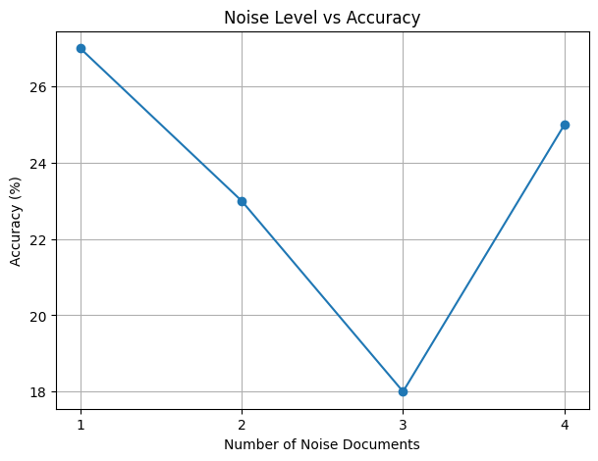
Results Graph:
Analysis:
1-2 noise documents: Some focus maintained.
3+ noise documents: Attention collapse observed.
Random noise introduces entropy, disrupting model concentration.
Key Observations:
Minor noise can sometimes stabilize focus (noise=4 slight recovery).
But overall trend confirms retrieval relevance is critical.
LLMs are highly sensitive to distractor documents.

Slide 9

Future Work
Extend experiments using Contriever, BM25, and Adore retrievers.
01
Evaluate larger models: LLaMA 2, Mistral, Falcon-7B.Explore entropy-based document ordering to reduce attention collapse.
02
Train LLMs to be noise-resilient via reinforcement learning.
03

Slide 10
THANK YOU !

